Slide 1
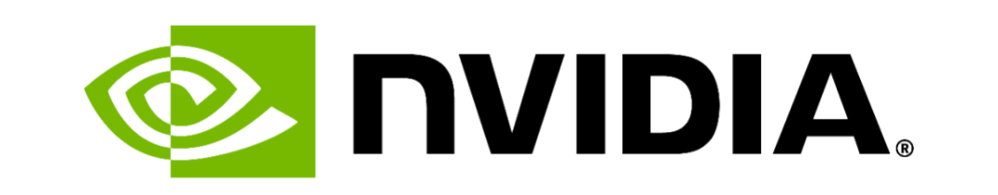

Slide 2
Company Background
Services: Leading global manufacturer of high-end Graphics Processing Units
Founder, Founding Year : Jensen Huang, 1933 as a result of his love for gaming
Interesting CEO facts : Huang - CEO and founder, known for his iconic Biker Jackets, Philanthropic Efforts
Name Origin - NVIDIA, Latin for ‘Envy’
Company’s Mergers and Acquisition in the last 10 years- Mellanox Technologies (2019), Cumulus Networks (2020), ARM Holdings (2020), Excelero (2022)
Company Size: 31,000+ employees in 36 countries
Company's Culture: -
No. 1 “World’s Most Innovative Companies” – Fast Company
“Best Places to Work in 2024” – Glassdoor
“Best CEO of 2023” – The Economist
Hiring Slogan: “Like No Place You’ve Ever Worked”
Employees take on Company’s Work Culture:-
‘Fantastic, the #1 place in the world to work at’ (Business Analyst, NVIDIA)
‘‘Great pay, open internal culture, and skilled coworkers. Engineers are encouraged to contribute where there is intersection between skills and need’ (Senior Software Engineer, NVIDIA)
Company’s mission statement : “ We advance computing to tackle impactful challenges no other companies can and problems that are nearly impossible today. In doing so, we create future markets and a better tomorrow.” (A letter from Jensen, 2023)
Notes:
s&p // earnings info

Slide 3
Company Background
KEY FACTS
CULTURE
Services: Leading global manufacturer of high-end Graphics Processing Units
Founders, Founding Year : Jensen Huang , Chris Malchowsky, Curtis Priem; 1993
Company Size: 31,000+ employees in 36 countries
Huang - CEO, known for his iconic Biker Jackets
“Best Places to Work in 2024” – Glassdoor
Core Values : Innovation, Speed & Agility, Intellectual Honesty, Excellence, One Team
Hiring Slogan: “Like No Place You’ve Ever Worked”
‘Fantastic, the #1 place in the world to work at’ (Business Analyst); ‘‘Great pay, open internal culture, skilled coworkers” (Senior SWE)
MISSION
RECENT M&A
“ We advance computing to tackle impactful challenges no other companies can and problems that are nearly impossible today. In doing so, we create future markets and a better tomorrow.” (A letter from Jensen, 2023)
Mellanox Technologies (2019)
Cumulus Networks (2020)
ARM Holdings (2020), Excelero (2022)
Notes:
Nvidia is a Leading global manufacturer of high-end Graphics Processing Units (i.e a very powerful computer chip that handles complex visuals and heavy workloads) founded by Jensen Huang, Chris and Curtis Priem in 1993 as a result of Jensen’s love for gaming. NVIDIA is Latin for ‘Envy’. The founders aimed to convey a sense of dominance in the market, with competitors being envious of their advanced graphics technology
Huang, the CEO of NVIDIA, is known for his iconic Biker Jackets and Philanthropic Efforts
Currently, as given on their website, NVIDIA has more than 31,000 employees in 36 countries
NVIDIA is one of America’s best places to work, according to Glassdoor’s list of best employers for 2024.
Their core values include Innovation, Speed & Agility, Intellectual Honesty, Excellence, One Team. By ‘One team’ they mean that there's only one team at NVIDIA. That means no politics, no hierarchy. Reporting lines exist, but teams form around projects based on the skills that are required.
Their Hiring Slogan very well sums up their culture which is NVIDIA is a place “Like No Place You’ve Ever Worked”. The company doesn't fall back on policy, trends, or norms. If it’s the right thing to do for their employees–for their families, for the work–the company finds a way to make it happen with compassion and respect. For them, It’s a commitment to supporting their teams holistically, not just as employees, but as humans. The company encourages its employees to take care of themselves and their families so that they can bring their whole self to work to do the work that they love.
We have given some examples on what NVIDIA’s employees have to say about the company’s culture. For instance, a Business Analyst, said that “It’s Fantastic, the #1 place in the world to work at’, Similarly, a Senior Software Engineer said ‘‘it has a Great pay, open internal culture, and skilled coworkers. Engineers are encouraged to contribute where there is intersection between skills and need’.
Also, MIT Sloan Management Review in collaboration with Glassdoor created a data-driven initiative called Culture 500, that evaluates the corporate culture of 500 of the largest and most influential companies in the United States. By analyzing employee reviews on Glassdoor, the survey provides insights into how employees perceive and experience their organization's culture. According to this survey, Nvidia’s employees believe that the company ‘walks the talk’ when it comes to its core values. This is evident in initiatives like the NVIDIA Inception Program, which supports startups developing groundbreaking AI technologies by providing resources, mentorship, and exposure, hence promoting “Innovation”.
Company’s mission statement is “ We advance computing to tackle impactful challenges no other companies can and problems that are nearly impossible today. In doing so, we create future markets and a better tomorrow.” (A letter from Jensen, 2023)
Nvidia has relied heavily on acquisitions to keep its place in the industry. The major acquisitions include Mellanox Technologies, Cumulus Networks, Bright Computing in 2022 and Run AI in 2024. Nvidia's proposal to acquire U.K.based semiconductor producer - Arm for $40 billion was terminated after the Federal Trade Commission blocked the deal, but it still holds a $147.3 million dollar stake in the company.
Sabrina will no be discussing the Marketing Strategy for NVIDIA, over to you Sabrina!
Share this ONLY IF Dr. Galit ASKS!! Example of How NVIDIA practices its core value- Innovation:
Innovation is the lifeblood of NVIDIA. The company fosters a culture where creativity and new ideas are not only welcomed but actively encouraged. NVIDIA’s open-door policy allows employees to share ideas directly with senior leadership, ensuring that innovation can come from anywhere within the organisation. This accessibility and encouragement create an environment where employees feel valued and empowered to think outside the box.

Slide 4
Marketing Strategy/Advertising: 4 Ps Analysis
Product: Nvidia Blackwell GPU, emphasizing its unprecedented performance for gaming and content creation, particularly for horror and sci-fi genres.
Price: Premium pricing strategy, It is positioned as a high-end product for enthusiasts and professionals.
Place: Available through major online retailers, computer hardware stores, and Nvidia's official website.
Promotion: Cross-promotional campaign with the Alien franchise, leveraging the iconic sci-fi horror brand to showcase the GPU's capabilities in rendering hyper-realistic, atmospheric environments and creatures.
Targeting the high-end gaming and content creation market in North America, with a focus on the 18-35 age demographic.

Slide 5
Marketing Strategy/Advertising
PRODUCT
PRICE
Nvidia Blackwell GPU
Emphasizes unprecedented performance for gaming & content creation
Particularly for horror and sci-fi genres
Premium pricing strategy
Positioned as a high-end product for enthusiasts and professionals
PLACE
PROMOTION
Available through
  Major online retailers
  Computer hardware stores
  Nvidia's official website
Cross-promotional campaign with the Alien franchise
Leverage iconic sci-fi horror brand
Showcase GPU's capabilities in rendering hyper-realistic, atmospheric environments and creatures
Notes:
Targeting the high-end gaming and content creation market in North America, with a focus on the 18-35 age demographic

Slide 6
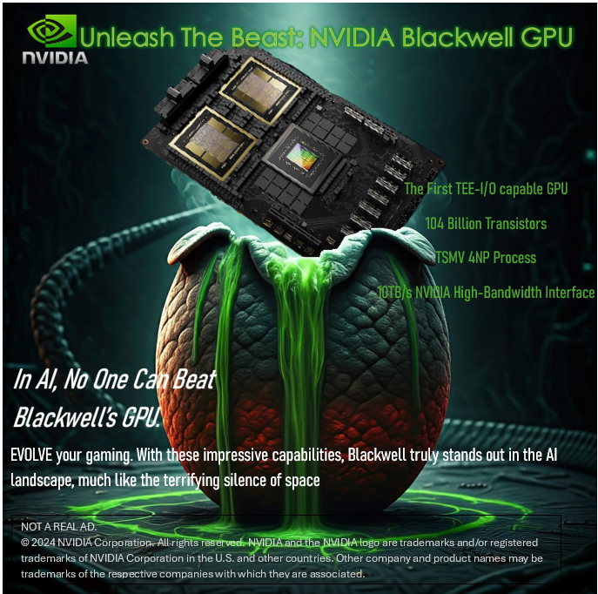
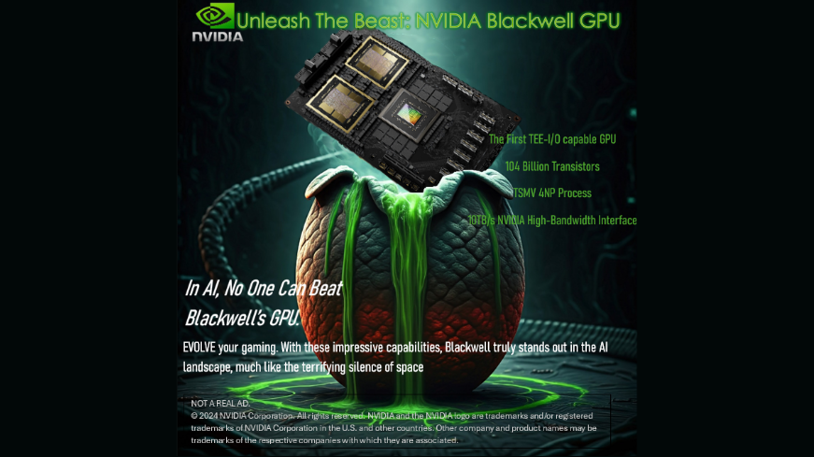
Explaining the Idea:
The Visual Concept: Inspired by the iconic Alien egg scene, reimagined with NVIDIA's signature elements.
Main Headline: Connects gaming culture and the Alien franchise.
Subheading: Plays on “In Space, no one can hear you scream.”- while emphasizing products capabilities.
Tagline: Ties the themes together and hopes to compel audience to be part of the next gaming evolution.
Notes:
Presentation: “From the depths of technological evolution... emerges a beast unlike anything you've encountered before.
The NVIDIA Blackwell GPU.
Featuring the first TEE-I/O capable architecture, powered by 104 billion transistors, and forged with TSMC 4NP process technology. This isn't just an upgrade – it's a technological metamorphosis.
With NVIDIA's High-Bandwidth Interface reaching 10TB/s, it doesn't just process – it dominates.
In AI, no one can beat Blackwell's GPU.
EVOLVE your gaming. NVIDIA Blackwell GPU – Unleash the Beast.”
The visual concept draws inspiration from the iconic Alien egg scene, reimagined with NVIDIA's signature elements. The GPU emerges from a biomechanical egg, dripping with the brand's characteristic green, symbolizing the birth of next-generation AI computing power.
The main headline 'Unleash The Beast' connects directly with both gaming culture and the Alien franchise's essence. The subheading 'In AI, No One Can Beat Blackwell's GPU' cleverly plays on the famous Alien tagline while emphasizing our product's AI capabilities.
The closing message 'EVOLVE your gaming' ties together the biological evolution theme of Alien with technological advancement, compelling our target audience to be part of the next evolution in computing

Slide 7
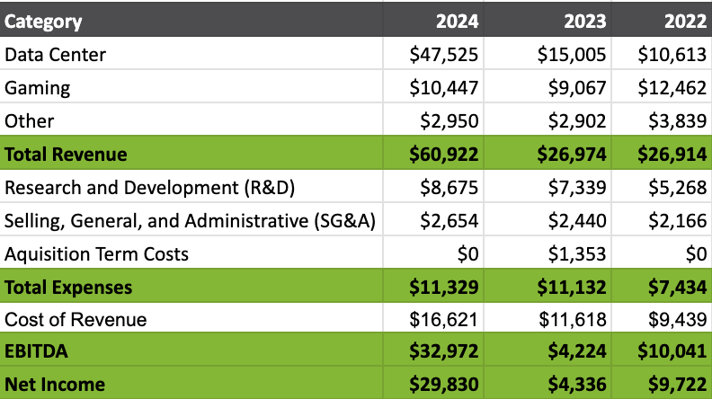
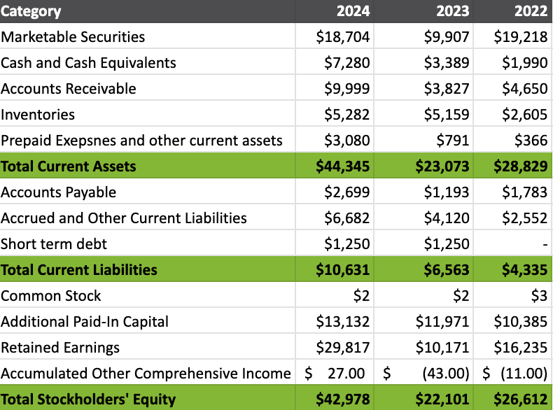
Financial Analysis: NVDA Income Statement & Balance Sheet
FYE: Jan 31st
Recommendations
Optimize inventory turnover
Monitor short term debt, 0 to $1B
Sustain growth trajectory, 4x in 2 years
Optimize cost of revenue (similar to cogs), Improve operational efficiency
Data Center growth
Liquidity Ratio: 4.17 (Current Asset / Current Liabilities)
Leverage Ratio: 0.52 (Debt / Total Equity) 22,750/ 42,978
Competitors have leverage ratios 0.4–1.0
Notes: Cost of Revenue represents technology company cost of intellectual capital like salaries
Notes:
Looking at their balance sheet on the right
1. Optimize inventory turnover: their inventory grew from 2B to 5B. Inventory worth 5B,
Looking at liabilities:
2. Note that there's introduction of short term debt, from 0 in 2022 to 1B, this should be monitored closely.
The liquidity ratio is 4.17, which means perhaps they can even leverage some more debt because they have a lot of cash.
On the left you see the income statement:
3. Revenue grew 4xs from 2022 to 2024, they should continue to invest in AI and cloud computing infrastructure, to sustain this growth trajectory.
4. Optimize cost of revenue, cost of revenue grew from 9.4B to 16.6B. They can explore ways to improve operational efficiency and supply chain cost to enhance gross margin
5. gaming revenue decline, Nvidia should analyze shifts in demand, especially in gaming and professional visualization markets, and consider innovative product offerings to regain growth. Which they are currently doing with blackwell chips
Accounting Excel Chart
https://docs.google.com/spreadsheets/d/1qmWhDgJHilctuD_QEdIpEe1KTZZTtm9i84jZ6EBrAF8/edit?gid=1447605533#gid=1447605533

Slide 8
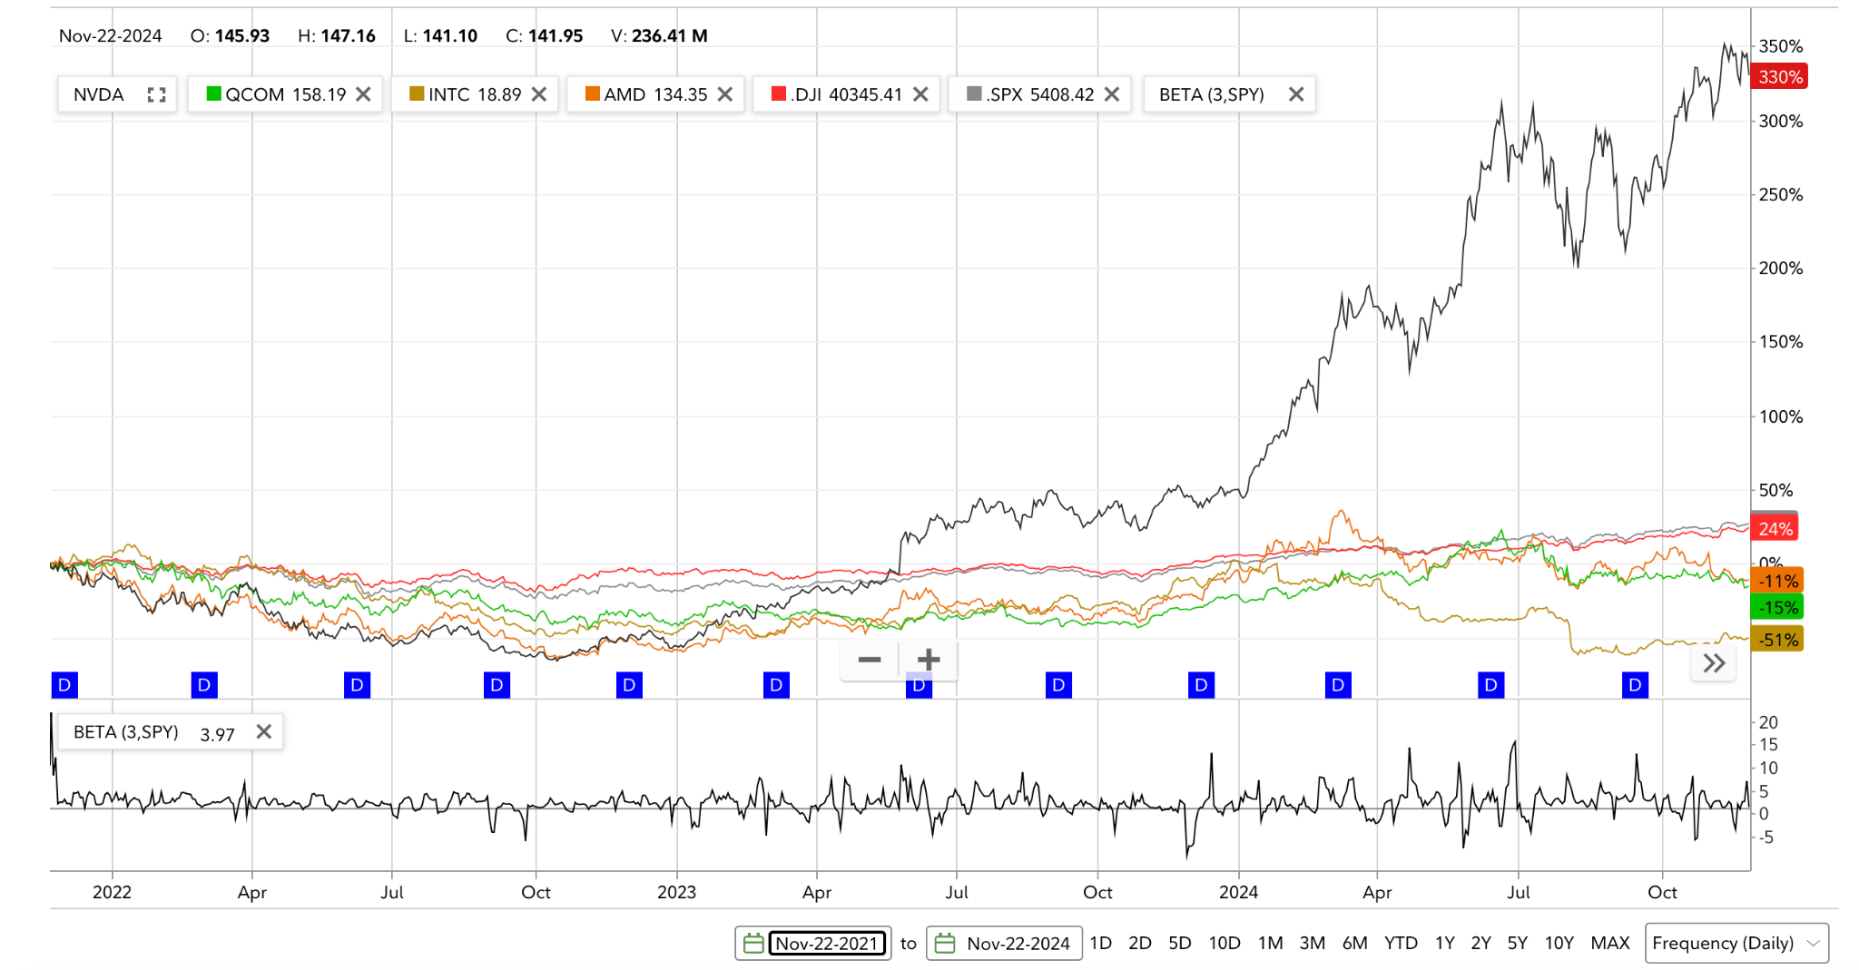
Financial Analysis: NVDA 3Y Comparative Stock Chart
P/E 66.59
Div Yield 0.03%
Source: Fidelity.com as of November 24, 2024

Slide 9
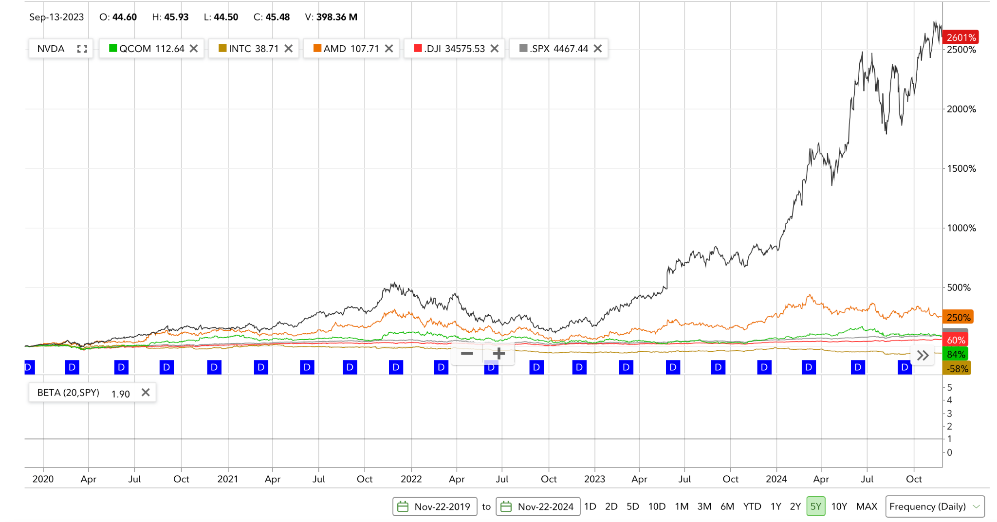
Financial Analysis: NVDA 5Y Comparative Stock Chart
Source: Fidelity.com as of November 24, 2024

Slide 10
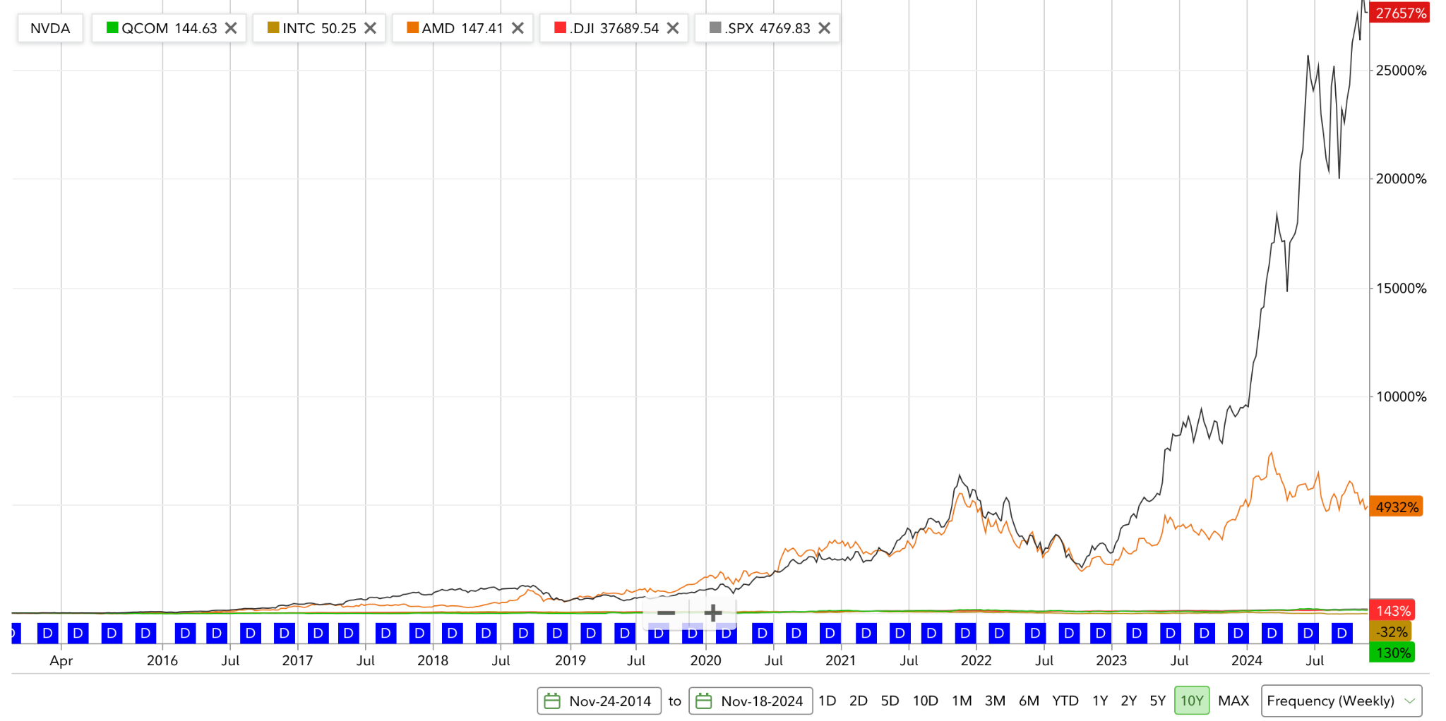
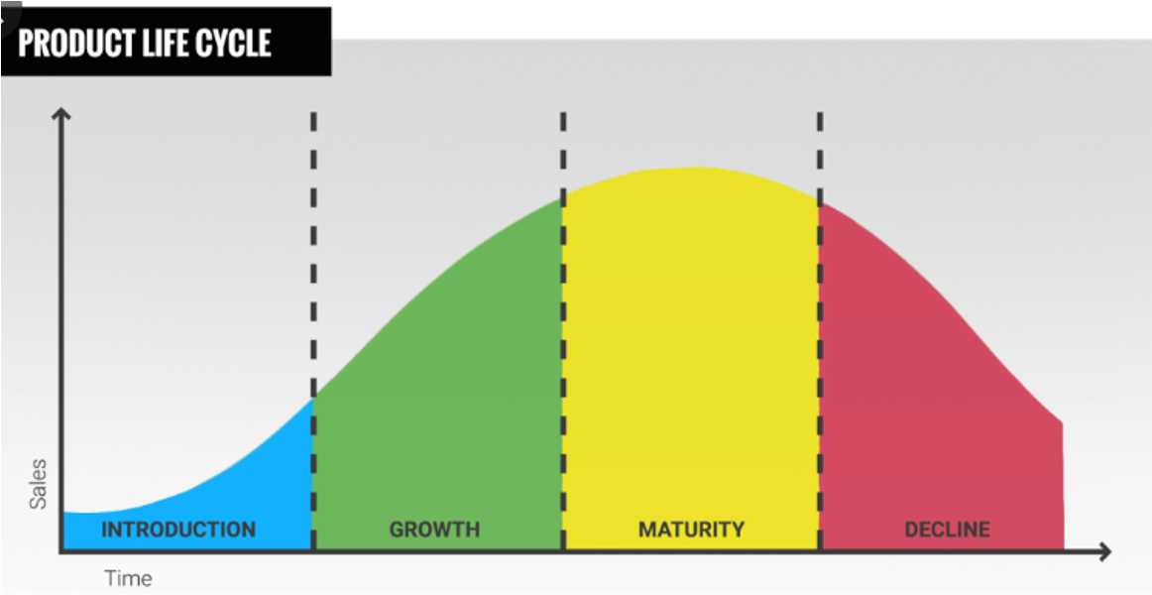
Financial Analysis: NVDA 10Y Comparative Stock Chart
Source: Functions of Organizations Marketing Presentation, Dr. Galit Ben-Joseph, Fall 2024
Source: Fidelity.com as of November 24, 2024

Slide 11
Financial Analysis
Growth
High Risk
Buy
High P/E ratio of 66.59, reflecting investor confidence in future growth.
Medium-to-high risk, with a beta of 3, indicating volatility.
BUY for long-term, growth-oriented investors. Investors should be comfortable with potential stock price fluctuations.
Primarily a growth company, driven by high reinvestment in R&D.
Strong presence in expanding sectors like AI, gaming, and data centers.
Exposed to volatile markets (gaming, crypto, AI), but supported by strong cash flow and leadership.
Rising competition in AI and data centers could add pressure.
High valuation favors long-term investment to capture growth.
Strong return potential if NVIDIA retains innovation lead in AI and data centers.
Notes:
Growth:
We’ve seen over 190% of growth this year, Continuous R&D Investment: NVIDIA’s massive investment in research and development—approximately $5.27 billion in 2022—ensures it stays ahead of the curve. Competitors struggle to match this level of sustained innovation.
- Extensive focus on R&D and rapid market expansion into industries like AI, Gaming, Data centers.
- recently joined S&P 500, however it’s PE ratio is still much higher than the average of 20-28 for S&P companies at 66.59
Based on beta of 3 given it’s great than 1, it’s considered high risk. Higher volatility compared to the market.
- this could also be due to the market it is targeting, being ai, data center and gaming, there’s high demand and the market is still pretty new.
- However, NVIDIA’s strong cash flow, leading position in AI and data centers, and well-diversified revenue streams provide some stability and a buffer against market fluctuations.
- Our recommendation is to Buy for long term growth oriented investors.
- Especially if you believe in the blackwell chip product they are building, As well as the growth of Future AI
- current development of blackwell chip is so advanced their competitors are severely lagging behind.
- Investors should be comfortable with some volatility and fluctuation of the stock. But overall we see continued growth
Growth vs. Value Classification:
NVIDIA is widely considered a growth company. This designation comes from its extensive reinvestment into R&D and its leadership in rapidly expanding industries like artificial intelligence (AI), gaming, and data centers. Its cutting-edge technology and innovative product lines are key drivers of revenue growth, making it attractive to growth-oriented investors looking for long-term capital appreciation. While NVIDIA’s recent profitability may lend some value characteristics in certain sectors, its high P/E ratio (currently at 36.7) underscores its growth-focused market perception, especially in comparison to the broader S&P 500 P/E average of 20-28. Nvidia Recently joined s&p 500.
Risk Level:
NVIDIA’s stock carries a medium-to-high risk level, reflecting its beta of 1.66. This beta indicates higher volatility than the overall market, suggesting that NVIDIA’s stock tends to experience larger price swings. The company’s reliance on demand from volatile markets, such as gaming, cryptocurrency mining, and AI, also contributes to this risk profile. However, NVIDIA’s strong cash flow, leading position in AI and data centers, and well-diversified revenue streams provide some stability and a buffer against market fluctuations.
Analyst Recommendation:
Given NVIDIA’s strong growth prospects, technological leadership, and promising revenue potential in high-demand sectors, a "BUY" recommendation is appropriate for long-term investors with a higher risk tolerance. The company’s innovation in AI and data centers, along with its recent profitability and cash flow generation, positions it well for continued success. However, the high valuation and stock volatility mean this recommendation is suited to those prepared for potential fluctuations. In the future, if competitive pressures increase or NVIDIA’s growth rate declines, a shift in strategy might be warranted, but the current outlook supports a buy stance for growth-focused investors.

Slide 12
Strategic Plan
Market Penetration
Product Development
Market penetration is a lower-risk strategy that allows NVIDIA to consolidate and expand its leadership in its current markets | ‘All in’ on new product development by iterating with Blackwell chips – continue this to remain 2 years ahead of rivals
Involves higher risks and should take a secondary priority to market penetration and product development. | Related diversification by leveraging its expertise in GPUs and AI to expand into high-growth markets like autonomous vehicles, robotics, and edge computing,
Ansoff Product vs. Market Matrix
Market Development
Diversification
Notes:
Product development: New product in existing market:
NVIDIA’s significant R&D investments position it as a leader in innovation, especially in cutting-edge markets like AI and autonomous vehicles. Product development aligns with NVIDIA’s innovation focus and long-term growth vision. This will also help them enter new markets with new products they continue to develop
Increase Existing Market Share with Current Products (Market Penetration)
NVIDIA already has a dominant position in core markets such as AI, gaming, and data centers.
These markets are growing rapidly, particularly with the increasing adoption of AI in enterprise applications and the growing demand for gaming hardware globally. By increasing market share in these areas, NVIDIA can capitalize on its existing products without taking on the risks associated with new product development or new market entry.
Diversification: could approach with M&A, to capture market and product.
Market Penetration to increase its dominance in existing markets like AI, gaming, and data centers.
Product Development to capitalize on emerging technologies and future-proof its position in fast-evolving industries like autonomous vehicles and quantum computing.

Slide 13
Strategic Plan
Product Development
PRODUCTS
Market Penetration
EXISTING
NEW
Market penetration is a lower-risk strategy that allows NVIDIA to consolidate and expand its leadership in its current markets | ‘All in’ on new product development by iterating with Blackwell chips – continue this to remain 2 years ahead of rivals
Involves higher risks and should take a secondary priority to market penetration and product development. | Related diversification by leveraging its expertise in GPUs and AI to expand into high-growth markets like autonomous vehicles, robotics, and edge computing,
Ansoff Product vs. Market Matrix
EXISTING
MARKETS
NEW
Market Development
Diversification
Notes:
What makes them special is their product and market they target, for them to continuously beat competitors in the product lifecycle curve.
foresight positioned them as the go-to hardware provider for AI workloads. (as early as 2006)
they also develop software ecosystems like CUDA and AI frameworks, which make it difficult for competitors to replicate their success. Their software and hardware integration creates a moat that ties developers and enterprises to their products.
NVIDIA works closely with companies like TSMC for advanced semiconductor manufacturing and has strong partnerships with cloud providers like AWS, Google, and Microsoft.
Product development: New product in existing market:
NVIDIA’s significant R&D investments position it as a leader in innovation, especially in cutting-edge markets like AI and autonomous vehicles. Product development aligns with NVIDIA’s innovation focus and long-term growth vision. This will also help them enter new markets with new products they continue to develop
Increase Existing Market Share with Current Products (Market Penetration)
NVIDIA already has a dominant position in core markets such as AI, gaming, and data centers.
These markets are growing rapidly, particularly with the increasing adoption of AI in enterprise applications and the growing demand for gaming hardware globally. By increasing market share in these areas, NVIDIA can capitalize on its existing products without taking on the risks associated with new product development or new market entry.
Diversification: could approach with M&A, to capture market and product.
Market Penetration to increase its dominance in existing markets like AI, gaming, and data centers.
Product Development to capitalize on emerging technologies and future-proof its position in fast-evolving industries like autonomous vehicles and quantum computing.

Slide 14

Strategic Plan
Ansoff Product vs. Market Matrix
Porter’s 5 Forces
BCG Growth Matrix
‘All in’ on new product development by iterating with Blackwell chips – continue this to remain 2 years ahead of rivals
Entering new markets with AI services, providing fully integrated customer solutions
NVIDIA enjoys an extraordinary AI moat on its GPUs so threatened by new entrants
Holds buying power over suppliers and selling power of customers
GPU chips are a STARS product with hyper growth + high market share
Video chips are cash cow
Sources: Ansoff 1957, Porter [date] and BCG Growth Matrix [date]
Notes:
Blackwell chips - Marketing to hyper / ansoff > product lifecycle S curve // Future blackwell chips // jumping product curve. Everytime they are reaching maturity, they improving, their performance is elevating rapidly. Quad in 2 years.

Slide 15
Recommendation for NVDA: add new products to existing markets, like AI customer specialized solutions, while iterating on Blackwell
Ansoff Product vs.
Market Matrix¹
GDP Outlook:
C+I+G+X
Macro Backdrop
‘All in’ on new product development by iterating with Blackwell chips – continue this to remain 2 years ahead of rivals (monopolistic competition)
Entering new markets with AI services, providing fully integrated customer solutions
No impending recession & technological innovation moat creates unique circumstances
Unemployment remains low at 4.1%²
US GDP 3Q ‘24 equals $29.35tn³, which represents a 2.8% growth rate from 2Q ‘24, remaining stable and strong
Consumer spending: outlook is stable and positive with unemployment steady
Private spending: outlook remains positive and steady
  Hyperscalers maintain capex on AI chips for data centers with FOMO moat
  New customer opportunities with autonomous vehicles
Government spending:
  US Chips Act creates a more secure environment for NVDA, minimizing supply chain disruptions
Net Exports: National security priority to limit exports
Notes:
1 Ansoff, 1957
2 BLS as of October 2024
3 bea.gov as of October 2024
Notes:
Blackwell chips - Marketing to hyperscalers / ansoff > product lifecycle S curve // Future blackwell chips // jumping product curve. Everytime they are reaching maturity, they improving, their performance is elevating rapidly. Quad to remain 2 years ahead of rivals.
Our recommendation for NVIDIA’s growth strategy aligns with the Ansoff Product-Market Matrix by focusing on both product development and market development. First, we suggest going 'all in' on new product development by iterating with Blackwell chips, ensuring they stay two years ahead of competitors in monopolistic competition (they have the cash to do this!) This approach reinforces their leadership in high-performance computing through continuous innovation and customer-focused iteration. Second, we recommend expanding into new markets with AI services, offering fully integrated customer solutions that combine their cutting-edge hardware with tailored AI applications. This diversification not only opens new revenue streams in high-growth industries like healthcare and logistics but also strengthens NVIDIA’s position as a comprehensive leader in both hardware and AI-driven transformation."
Now I’ll turn it over to Sabrina to provide the macro backdrop

Slide 16
THANK YOU

